Slide 1
Lecture 11: System Development; UML
Goal: use a method that will enable HW / SW co-design
Approach: modify UML, a method originally developed for SW

Slide 2
System development:
Importance of “fault-free” … bugs can be lethal.
The 2003 North America blackout was triggered by a local outage that went undetected due to a race condition – 55 million people were without power
Smart ship USS Yorktown was left dead in the water in 1997 for nearly 3 hours after a divide by zero error
So can hardware errors or bad design:
The Therac-20 had hardware interlocks to prevent lethal doses of radiation that were removed in the Therac-25. Thus, unknown software defects that were effectively neutralized in the Therac-20 were exposed in the Therac-25 and caused several deaths (both machines used the same basic software).

Slide 3
Development process we will use:
“enhanced UML” combination of waterfall/agile models
(ideally, formal methods for safety/security critical units)
    UML—Unified modeling language
    Originally developed for software
    A popular choice for embedded systems (with some enhancements)
    Can meet standards for a good development process:
    efficient
    cost-effective
    capable of producing a high-quality product

Slide 4
Capability Maturity Model
CMM : capability maturity model--defines level of the development process itself
1. Initial: ad hoc
2. Repeatable: basic project management processes in place
3. Defined: documented process integrated into an organization-wide software process
4. Managed: detailed measures are collected
Optimizing--desired level: Continuous process improvement from quantitative feedback
Question 1: what software / hardware / system process models have you used? How large / complex was the project? What level did the associated process represent?
Question 2: what level can we reach in a semester class?

Slide 5
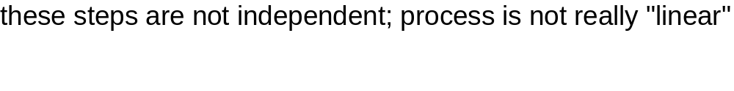
Product Life Cycle
Easier --Gather requirements
(cheaper) (levels:1. functional
to fix 2. performance
mistakes 3. implementation
4. use
5. maintenance)
--Develop specifications
--Design
--Implement
harder to fix --Test
mistakes --Maintain

Slide 6
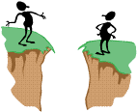
Requirements / specification
Requirements Analysis and Specification
requirements
customer
developer
specifications

Slide 7
Requirements Analysis and Specification:
Requirements / Specification:
----What is needed?
----If there is a current implementation, what are the problems
with it?
----How can we translate customer needs and wants into a
usable specification for the design stage?
Initially, requirements may be fuzzy and poorly stated--analysis stage sharpens and focuses the (customer) requirements

Slide 8
Tools for requirements analysis
Some tools for requirements analysis & specification:
Requirements:
----formal requirements document
Specification:
----use cases (UML)
----”user stories” (XP)

Slide 9
Specification:
must be as complete as possible, consistent, clear

Slide 10
Principles of specification:
functionality should be separate from implementation
  WHAT MUST BE DONE, NOT HOW
2. model of system behavior must include both data and functional responses to external stimuli
3. interaction with other components must be specified
4. environment of operation must be defined
5. "cognitive model" should describe the system as seen by the user community; do not create a design or implementation model
6. must be tolerant of incompleteness and allow for additions
7. must allow for change

Slide 11
Result of specification step: System Requirements Specification
must include:
--complete information description
--detailed functional description
--representation of system behavior
--performance requirements
--design constraints
--appropriate validation criteria (for example, acceptance tests)
--…….

Slide 12
Project Specification
This class:
Specifications will be written as UML (unified modeling language) use cases, along with text descriptions
System acceptance tests will be written along with specifications (DFT!!!!)

Slide 13
UML: a language for specifying and designing an OO project
UML: stands for "unified modeling language”
unifies methods of Booch, Rumbaugh (OMT or Object Modeling Technique), and Jacobson (OOSE or Object-Oriented Software Engineering)
mainly a modeling language, not a complete development method
Early versions -- second half of the 90's
Not all methods we will use are officially part of the UML description

Slide 14
Using UML in a project: design; design for testability
Design: “top-down”; Test: “bottom-up” : “Design for testability”
determine specifications:
use cases system tests
determine classes [modules] and connections (static behavior):
ER or class diagrams; CRC cards module (“black box”) tests
model dynamic behavior:
interaction (object message) diagrams
activity diagrams
state diagrams (fsm’s)
sequence diagrams
[ individual class & component methods “white box” or “glass box” tests]

Slide 15
  USE CASES:
  a part of the ”Unified Modeling Language" (UML) which we will use for requirements analysis and specification
  each identifies a way the system will be used and the "actors" (people or devices) that will use it (an interaction between the user and the system)
  each use case should capture some user-visible function and achieve some discrete goal for the user
  an actual user can have many actor roles in these use cases
  an instance of a use case is usually called a "scenario”
  Use case will typically have graphical & verbal forms

Slide 16
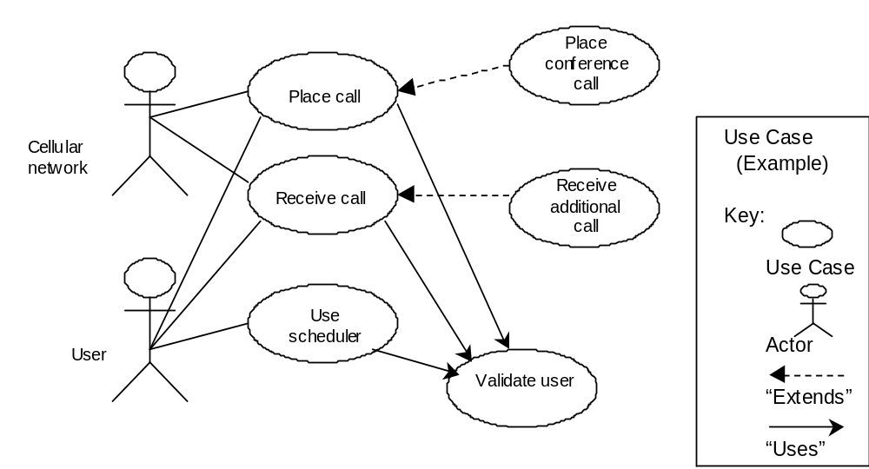
Example: cellular network place and receive calls use case (based on Booch, Rumbaugh, and Jacobson, The Unified Modeling Language User Guide)
Text description
--Use case name
(cellular network place
and receive calls)
--Participating actors
(cellular network and
human user)
--Flow of events
(network or user
accesses network to
use its functionality)
--Entry condition(s)
(user accesses
network using device
or password)
--Exit condition(s)
(call completed
lost or network busy)
--Quality requirements
(speed, service quality)
System boundary
Use case diagram—summarizes,
provides system overview
Text description—gives important details which may not be representable graphically

Slide 17
Example: “SAFEHOME” system (Pressman)
Use case: InitiateMonitoring
Participating actors:_______
Flow of events:_______
Entry condition(s):_______
Exit condition(s):_______
Quality requirements:_______
(What is in HW, what is SW?)
Arms/disarms
system
Homeowner
Accesses system
via internet
Sensors
Responds to
alarm event
Encounters an
error condition
System administrator
Reconfigures
sensors
and related
system features
Pressman,
p. 163,
Figure 7.3

Slide 18
Use case additions—simplifications of use case descriptions
  A. Include: one use case includes another in its flow of events (cases A and B both include case C)
  Extend: extend one use case to include additional behavior (cases D and E are extensions of case F)
<<include>>
A
C
B
<<include>>
<<extend>>
D
F
E
<<extend>>

Slide 19
  C. Inheritance: one use case specializes the more general behavior of another G and H specialize behavior of J)
G
J
Authenticate with password
authenticate
H
Authenticate with card

Slide 20
Examples:
what would be a hardware use case for a vending machine?
What might be a software use case?
What could be a general use case (hw or sw?)
HW SW Either
Use case name
Participating actors
Flow of events
Entry condition
Exit condition
Quality requirements

Slide 21
Our use cases will form a basis for system acceptance tests
For each use case:
  Develop one or more system tests to confirm that the use case requirements will be satisfied
  Add explicit test values as soon as possible during design phase
  These tests are now specifically tied to the use case and will be used as the top level acceptance tests
  Do not forget use cases / tests for performance and usability requirements (these may be qualitative as well as quantitative; they may be attached to functional use cases or may be written generally for the whole system)

Slide 22
Use case writing guide:
--each use case should be traceable to requirements
--name should be a verb phrase to indicate user goal
--actor names should be noun phrases
--system boundary needs to be clearly defined
--use active voice in describing flow of events, to make clear who does what
--make sure the flow of events describes a complete user transaction
---if there is a dependence among steps, this needs to be made clear
--describe exceptions separately
--DO NOT describe the user interface to the system, only functions
--DO NOT make the use case too long—use extends, includes instead
--as you develop use cases, develop associated tests

Slide 23
Assignment (HOMEWORK ASSIGNMENT):
Traffic light system at MLK. Your task is to develop specifications (USE CASES) for this new system. The specifications should NOT be tied to implementation on your board or on any other board, choice of platform and division into HW / SW will be decided AFTER specifications are written.
Complete specifications would probably address:
a. Functional specifications—what does the system do?
b. Regulatory agency requirements (if any)
c. Customer requirements (City of Cincinnati)
d. User requirements (cars, pedestrians)
e. Reliability requirements (e.g., time to failure, fault rate)
f. Safety requirements
g. Security requirements
h. Quality requirements not covered in other categories:
i. Performance
j. Power needs
k. Size / weight
l. Cost
m. Usability, User-friendliness
n. Operating conditions
Identify the specifications which can be described with (functional) UML use cases and develop these use cases; include system tests for these cases
Include nonfunctional specifications with each functional use case, as appropriate, or develop nonfunctional use cases
2. Can you write specifications as state diagram (s), with text descriptions of additional specifications?
3. BRIEFLY discuss the strengths and weaknesses of each approach (UML vs state diagram(s)).

